Slide 1

TABLEAU ASSIGNMENTS
01-11-2025
Day 10 of #50DaysOfDataAnalytics

Slide 2
ASSIGNMENT QUESTIONS
ASSIGNMENT 1 :
Create a table with columns such as category, sub-category in rows and region in columns with total sales and total profit shown for each region along with grand total and percent of pane total sorted by sum of sales in descending manner as shown in below image.
ASSIGNMENT 2 :
From the Netflix Titles dataset, merge tables using Inner Joins and identify the actor/actress with the highest number of appearances in Sports Movies. Provide the name of the actor/actress and the corresponding movie titles they've starred in.
ASSIGNMENT 3:
Create a Tableau histogram displaying the count of customers based on their order frequency, with the number of orders on the x-axis and the corresponding customer count on the y-axis
ASSIGNMENT 4:
Create a pie chart showing Top 50 customers Vs Other customers with respect to sum of sales shown in below image.

Slide 3
ASSIGNMENT 5:
Create a Tableau KPI card showcasing total
profit for the current year (last year of the dataset)
percentage growth from the previous year, indicated by a green upward arrow with a "+" sign for positive growth and a red downward arrow with a "-ve" sign for negative growth.
Incorporate a line chart depicting monthly profit trends for the current year.
ASSIGNMENT 6:
1) Create the parameter with name as View by. Use three values in parameter i.e., Region, Category and Sub-category. If the user selects any value, then show the sum of sales with respect to the value chosen in the parameter as a bar chart. E.g., If the user selects a category, then show category wise sales. Make sure to edit the worksheet title w.r.t. View by value.
2) Make groups for Acco, 3M, Samsung, Apple, Xerox products. (For remaining products included in others folder). Display each group as an average discount percentage

Slide 4
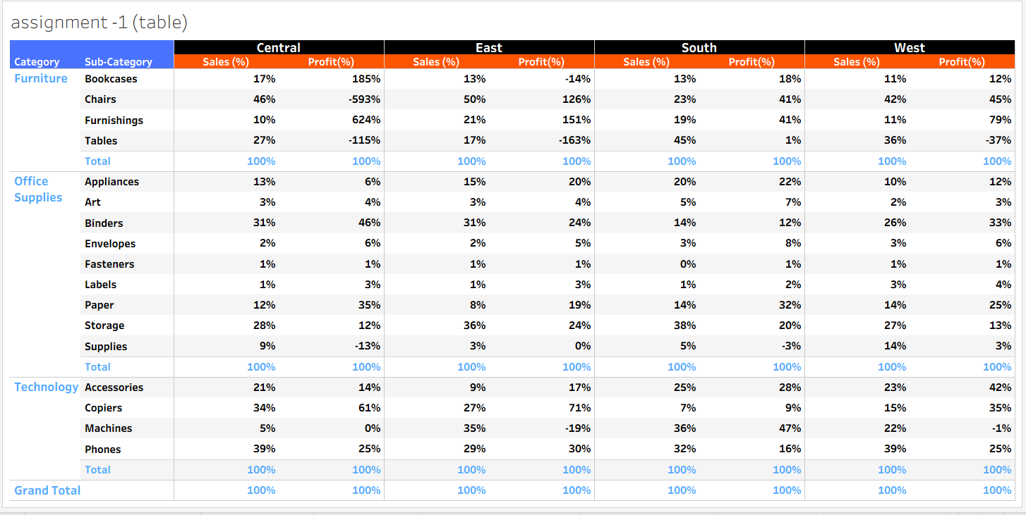
ASSIGNMENT 1
Create a table with columns such as category, sub-category in rows and region in columns with total sales and total profit shown for each region along with grand total and percent of pane total sorted by sum of sales in descending manner as shown in below image.

Slide 5
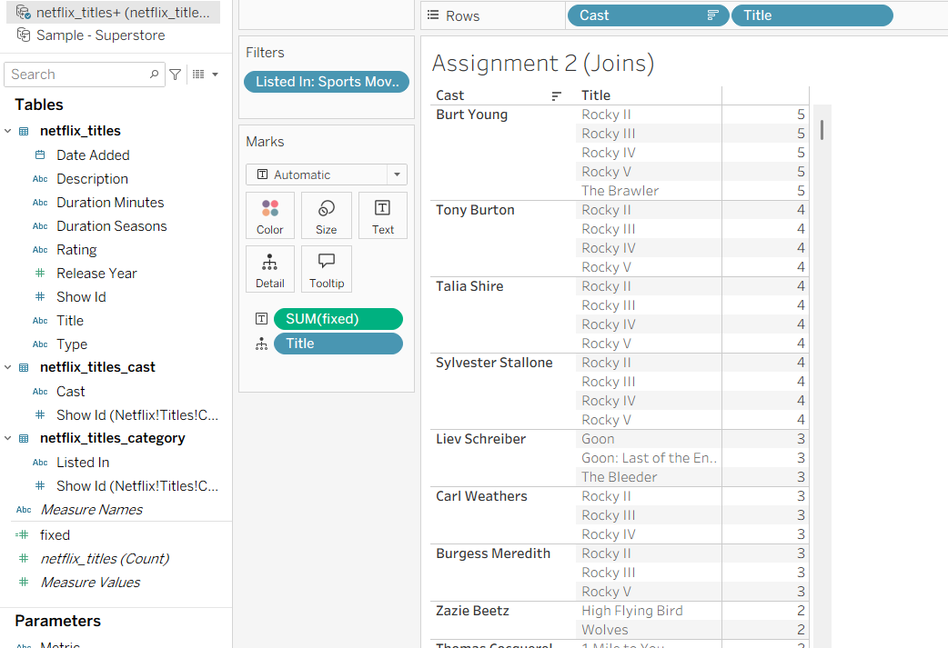
ASSIGNMENT 2
From the Netflix Titles dataset, merge tables using Inner Joins and identify the actor/actress with the highest number of appearances in Sports Movies. Provide the name of the actor/actress and the corresponding movie titles they've starred in.

Slide 6
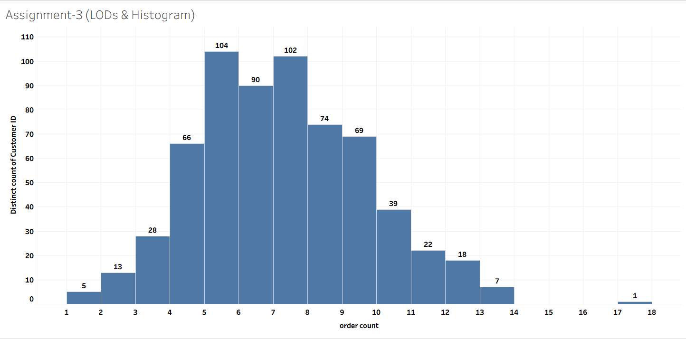
ASSIGNMENT 3
Create a Tableau histogram displaying the count of customers based on their order frequency, with the number of orders on the x-axis and the corresponding customer count on the y-axis

Slide 7
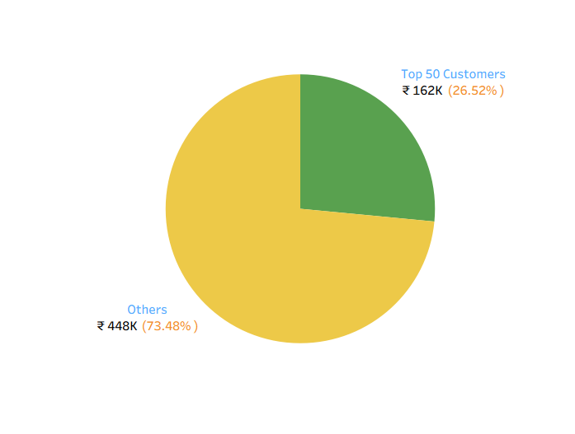
ASSIGNMENT 4
Create a pie chart showing Top 50 customers Vs Other customers with respect to sum of sales shown in below image

Slide 8
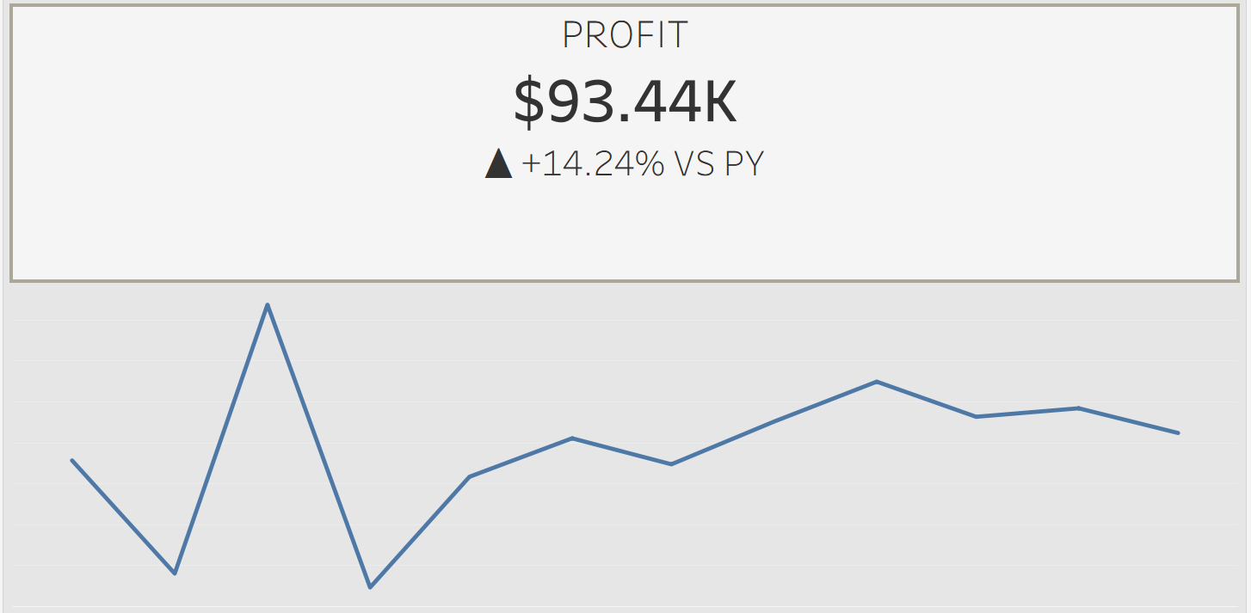
ASSIGNMENT 5
Create a Tableau KPI card showcasing total
profit for the current year (last year of the dataset)
percentage growth from the previous year, indicated by a green upward arrow with a "+" sign for positive growth and a red downward arrow with a "-ve" sign for negative growth.
Incorporate a line chart depicting monthly profit trends for the current year.

Slide 9
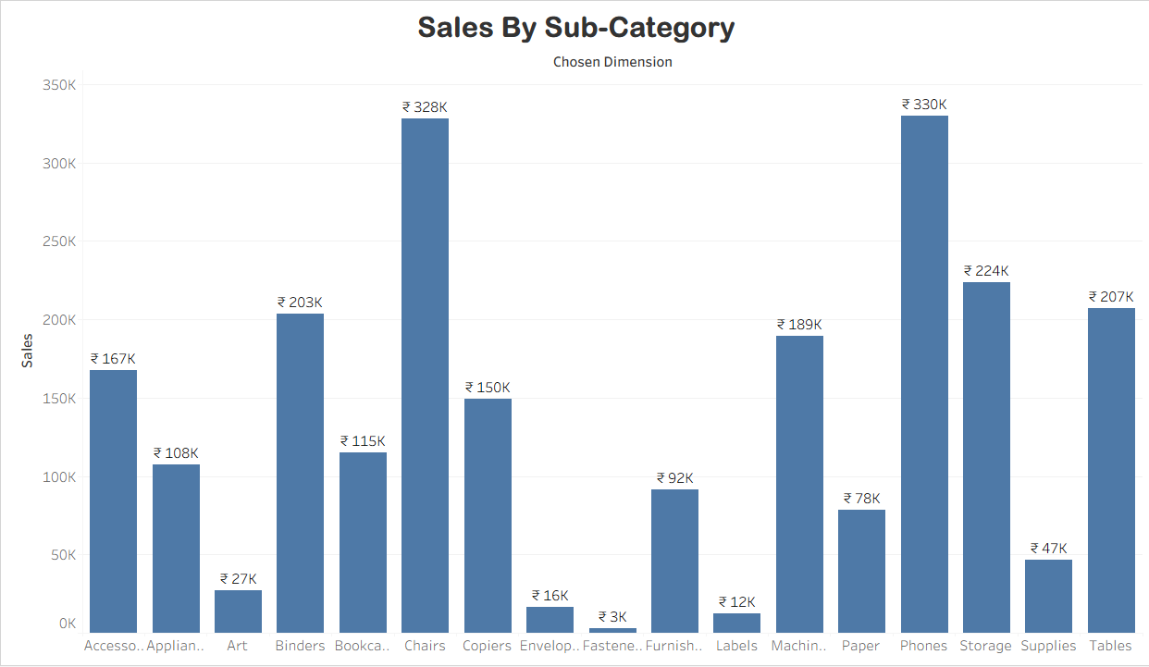
ASSIGNMENT 6 - a
Create the parameter with name as View by. Use three values in parameter i.e., Region, Category and Sub-category.
If the user selects any value, then show the sum of sales with respect to the value chosen in the parameter as a bar chart. E.g., If the user selects a category, then show category wise sales. Make sure to edit the worksheet title w.r.t. View by value.

Slide 10
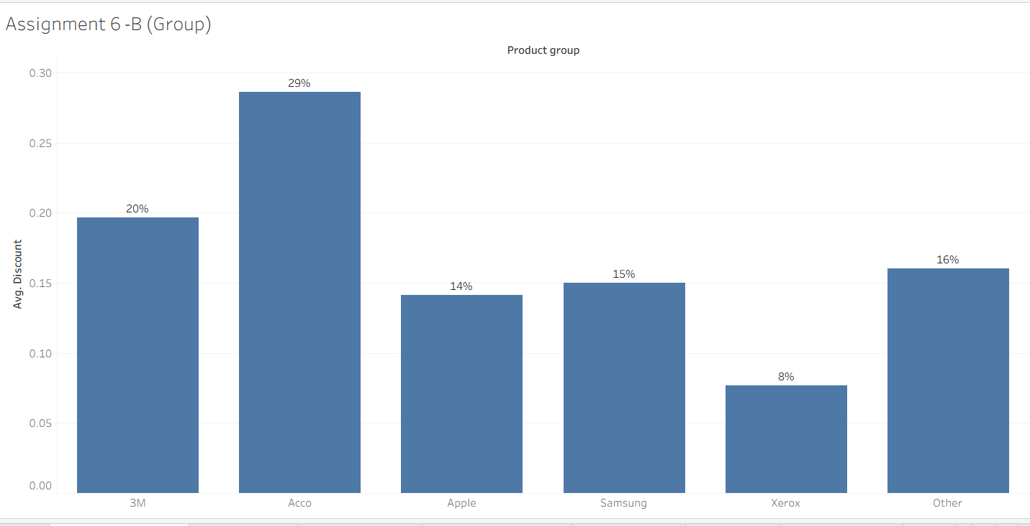
ASSIGNMENT 6 - b
2. Make groups for Acco, 3M, Samsung, Apple, Xerox products. (For remaining products included in others folder). Display each group as an average discount percentage

Slide 11



Thank You
Aditya Rajendra Kapse
aditya.rajendra.kapse@gmail.com
LINKEDIN
GITHUB

